Slide 1
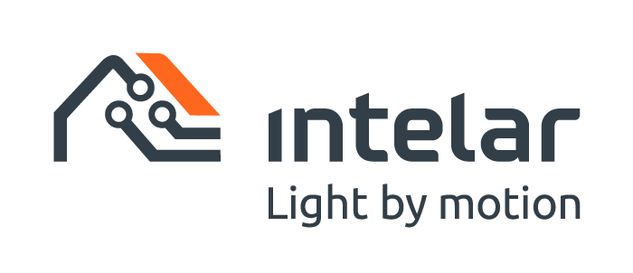
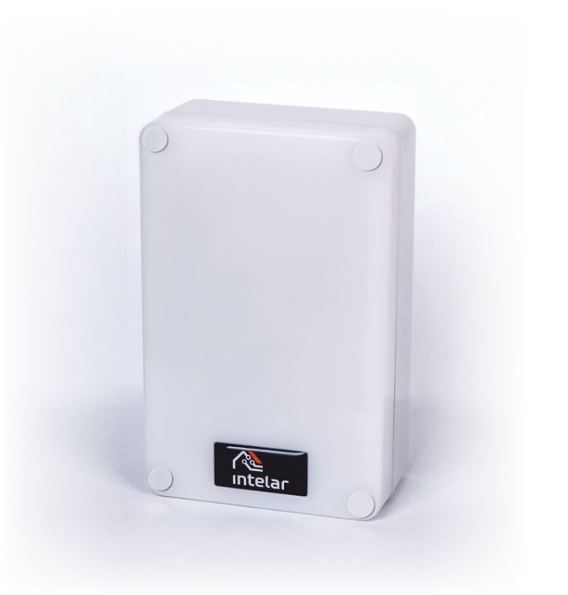
Long-range occupancy sensor for lighting control and automation warehouses, urban and industrial buildings and territories
UN Sustainable Development Goals
Cost-effective technology with a short payback period

Slide 2
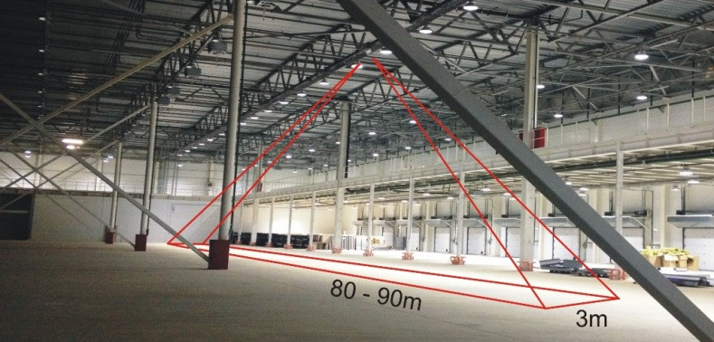
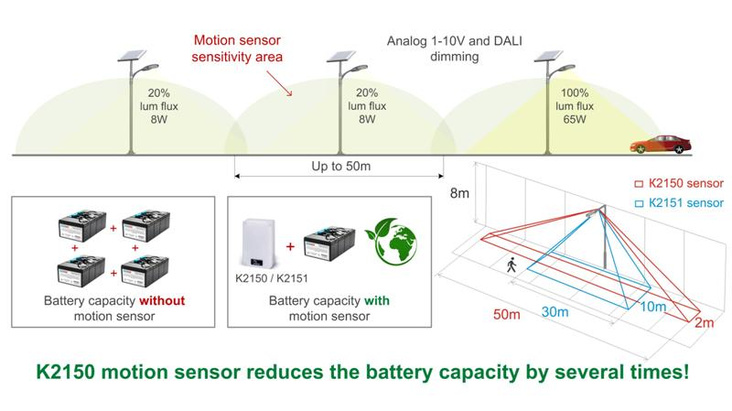
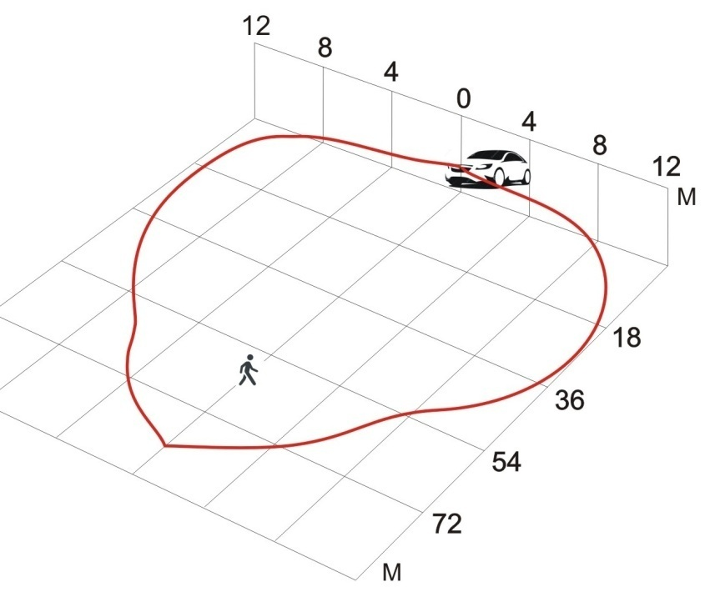
К2150 occupancy detector overview
Can be used in:
Lighting control and automation systems
Autonomous solar lighting systems – light by motion
IoT systems
Smart manufacturing, Smart City
Car2X
As a long-range low-cost automotive radar sensor
The sensor is ideal for warehouse lighting control

Slide 3
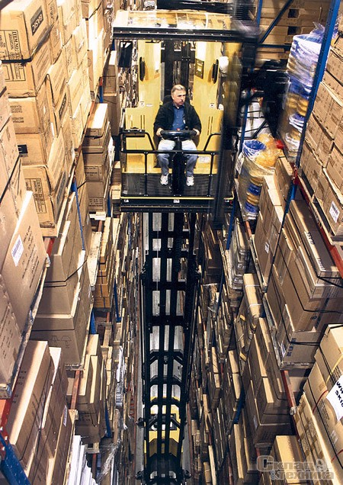
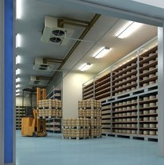
Case Study: Lighting control system for a warehouses
The Challenges
VNA
Most warehouses of old construction are not equipped with presence sensors. They consume about 3 times more energy than warehouses with automation
The sensors available on the market have a maximum installation height of 12 m. VNA-warehouses up to 22 m high are becoming popular now
Sensors offered on the market now:
- do not operate in freezing and high humidity warehouses (storage of vegetables, fruits…)
- cannot operate steadily in warehouses located in regions with warm and hot climates in summer

Slide 4
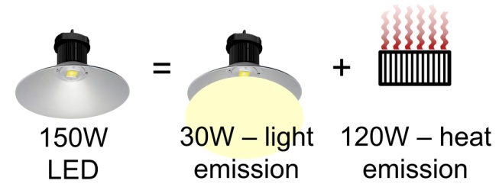
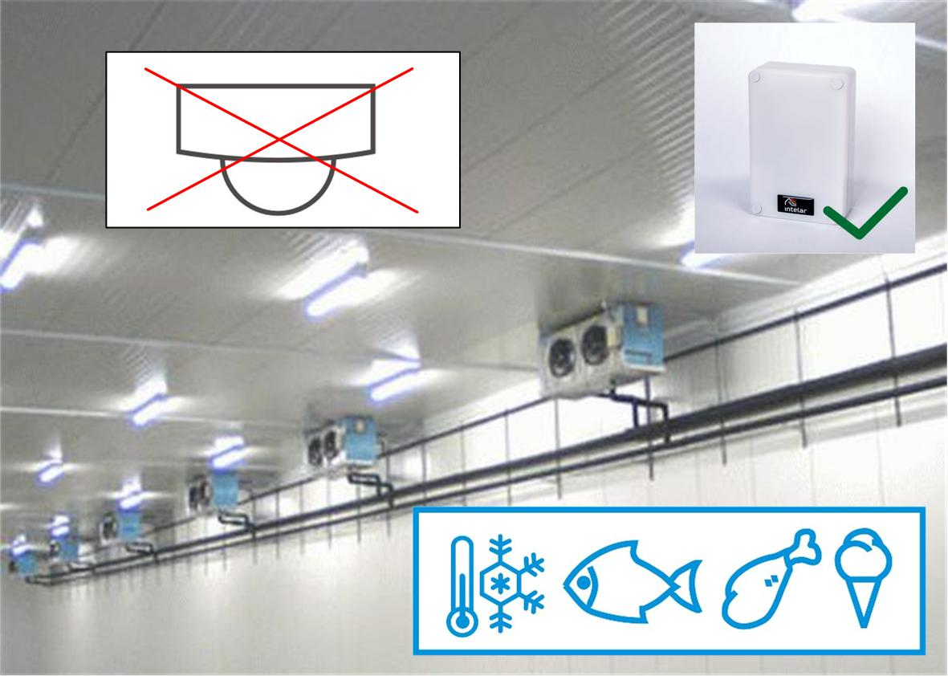
Case Study: Lighting control system for a warehouses
Why electric energy gets wasted twice in freezing warehouses?
150W light fixture = 120W heater (150W x 0.8 = 120W)!
100 pcs 150W light fixtures = 12kW heater and the cooling system of the warehouse must always compensate those parasite heat emissions.
+12kW heating – 12kW cooling = 0. Waste 24kW. Every hour!
In such a way, electric energy gets wasted twice – firstly, on the air heating by fixtures, secondly, on its cooling!
Why PIR-sensors can't operate in freezing warehouses?
Infrared motion sensors (PIR) are optical sensors with focusing lenses. In freezer warehouses lenses get covered by frost and the sensor can no longer detect any motions.

Slide 5
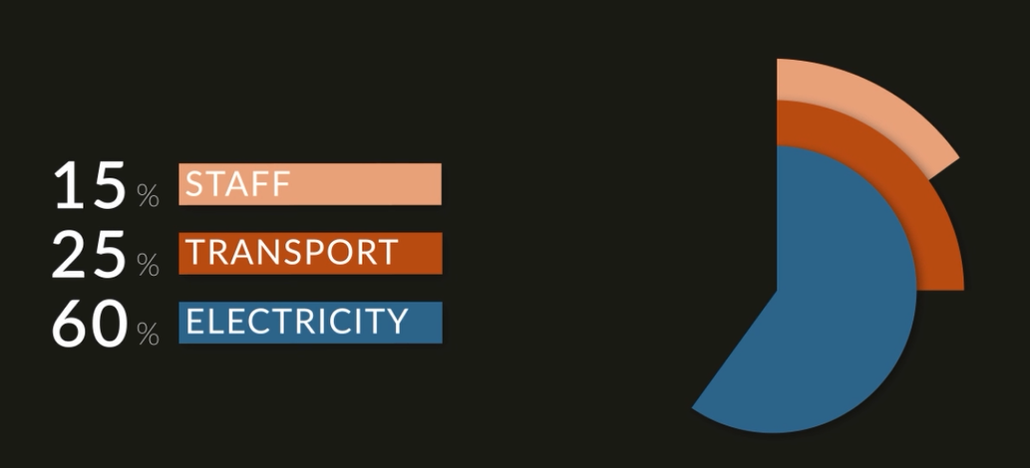
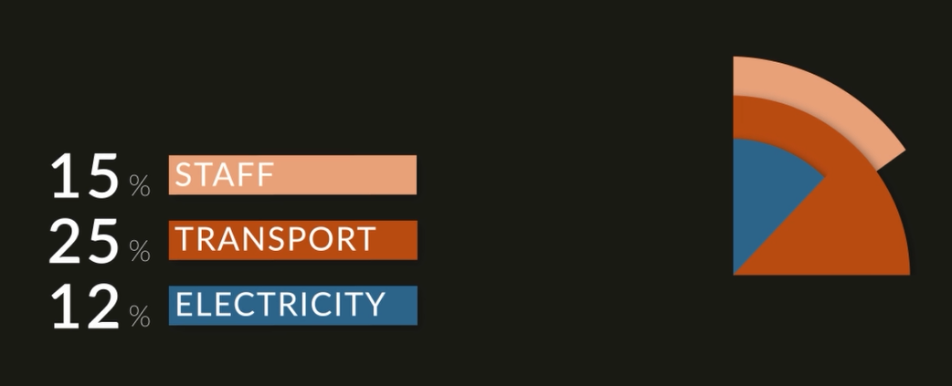
Case Study: Lighting control system for a warehouses
What the result could we have?
Before
After
Energy savings in warehouses lighting systems can reach up to 80%!
Even if you have energy efficient LED-light sources installed, we can reduce your energy costs several times more!

Slide 6
Solving the problem
K2150 vs Competitors
One sensor controls an inter-rack aisle up to 85m long (detection of humans )
and up to 115 m long (detection of vehicles) - real cases!
K2150 replaces 4 high-bay sensors of the world’s best manufacturers!
No competitors in warehouses with a height of more than 14m

Slide 7
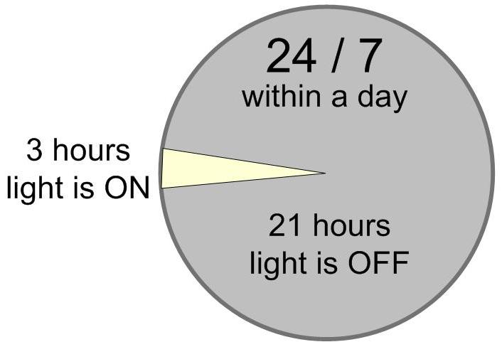
Case Study: Lighting control system for a warehouses
Why is it cost-effective to manage lighting in warehouses?
One sensor saves up to 10 000 kWh electric power and decrease emissions of СО2 in atmosphere
on 4 tones per year
Reduces the energy consumption of the lighting system by 3-4 times!
The payback period is approximately 1 year. Best result – 6.5 months!

Slide 8
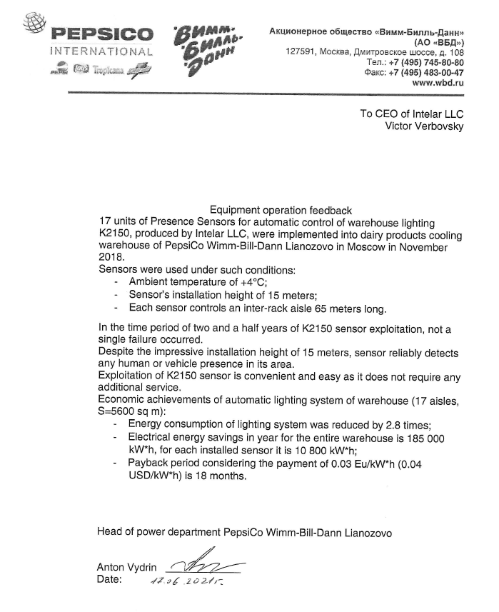
Feedback from PepsiCo
Economic achievements of automatic lighting system of warehouse (17 aisles, S=5600 sq m)
Sensor’s installation height - 15 meters
Each sensor controls an inter-rack aisle 65 meters long
kWh
Energy consumption and its cost per year
114 370 Eu
285 926
CO₂ 68 tons
40 418 Eu
101 046
Before
After
Savings - 184 880 kWh / 73 952 Eu * / 2.8 times
* - taking into account the price of energy 0.4 Eu/kWh

Slide 9
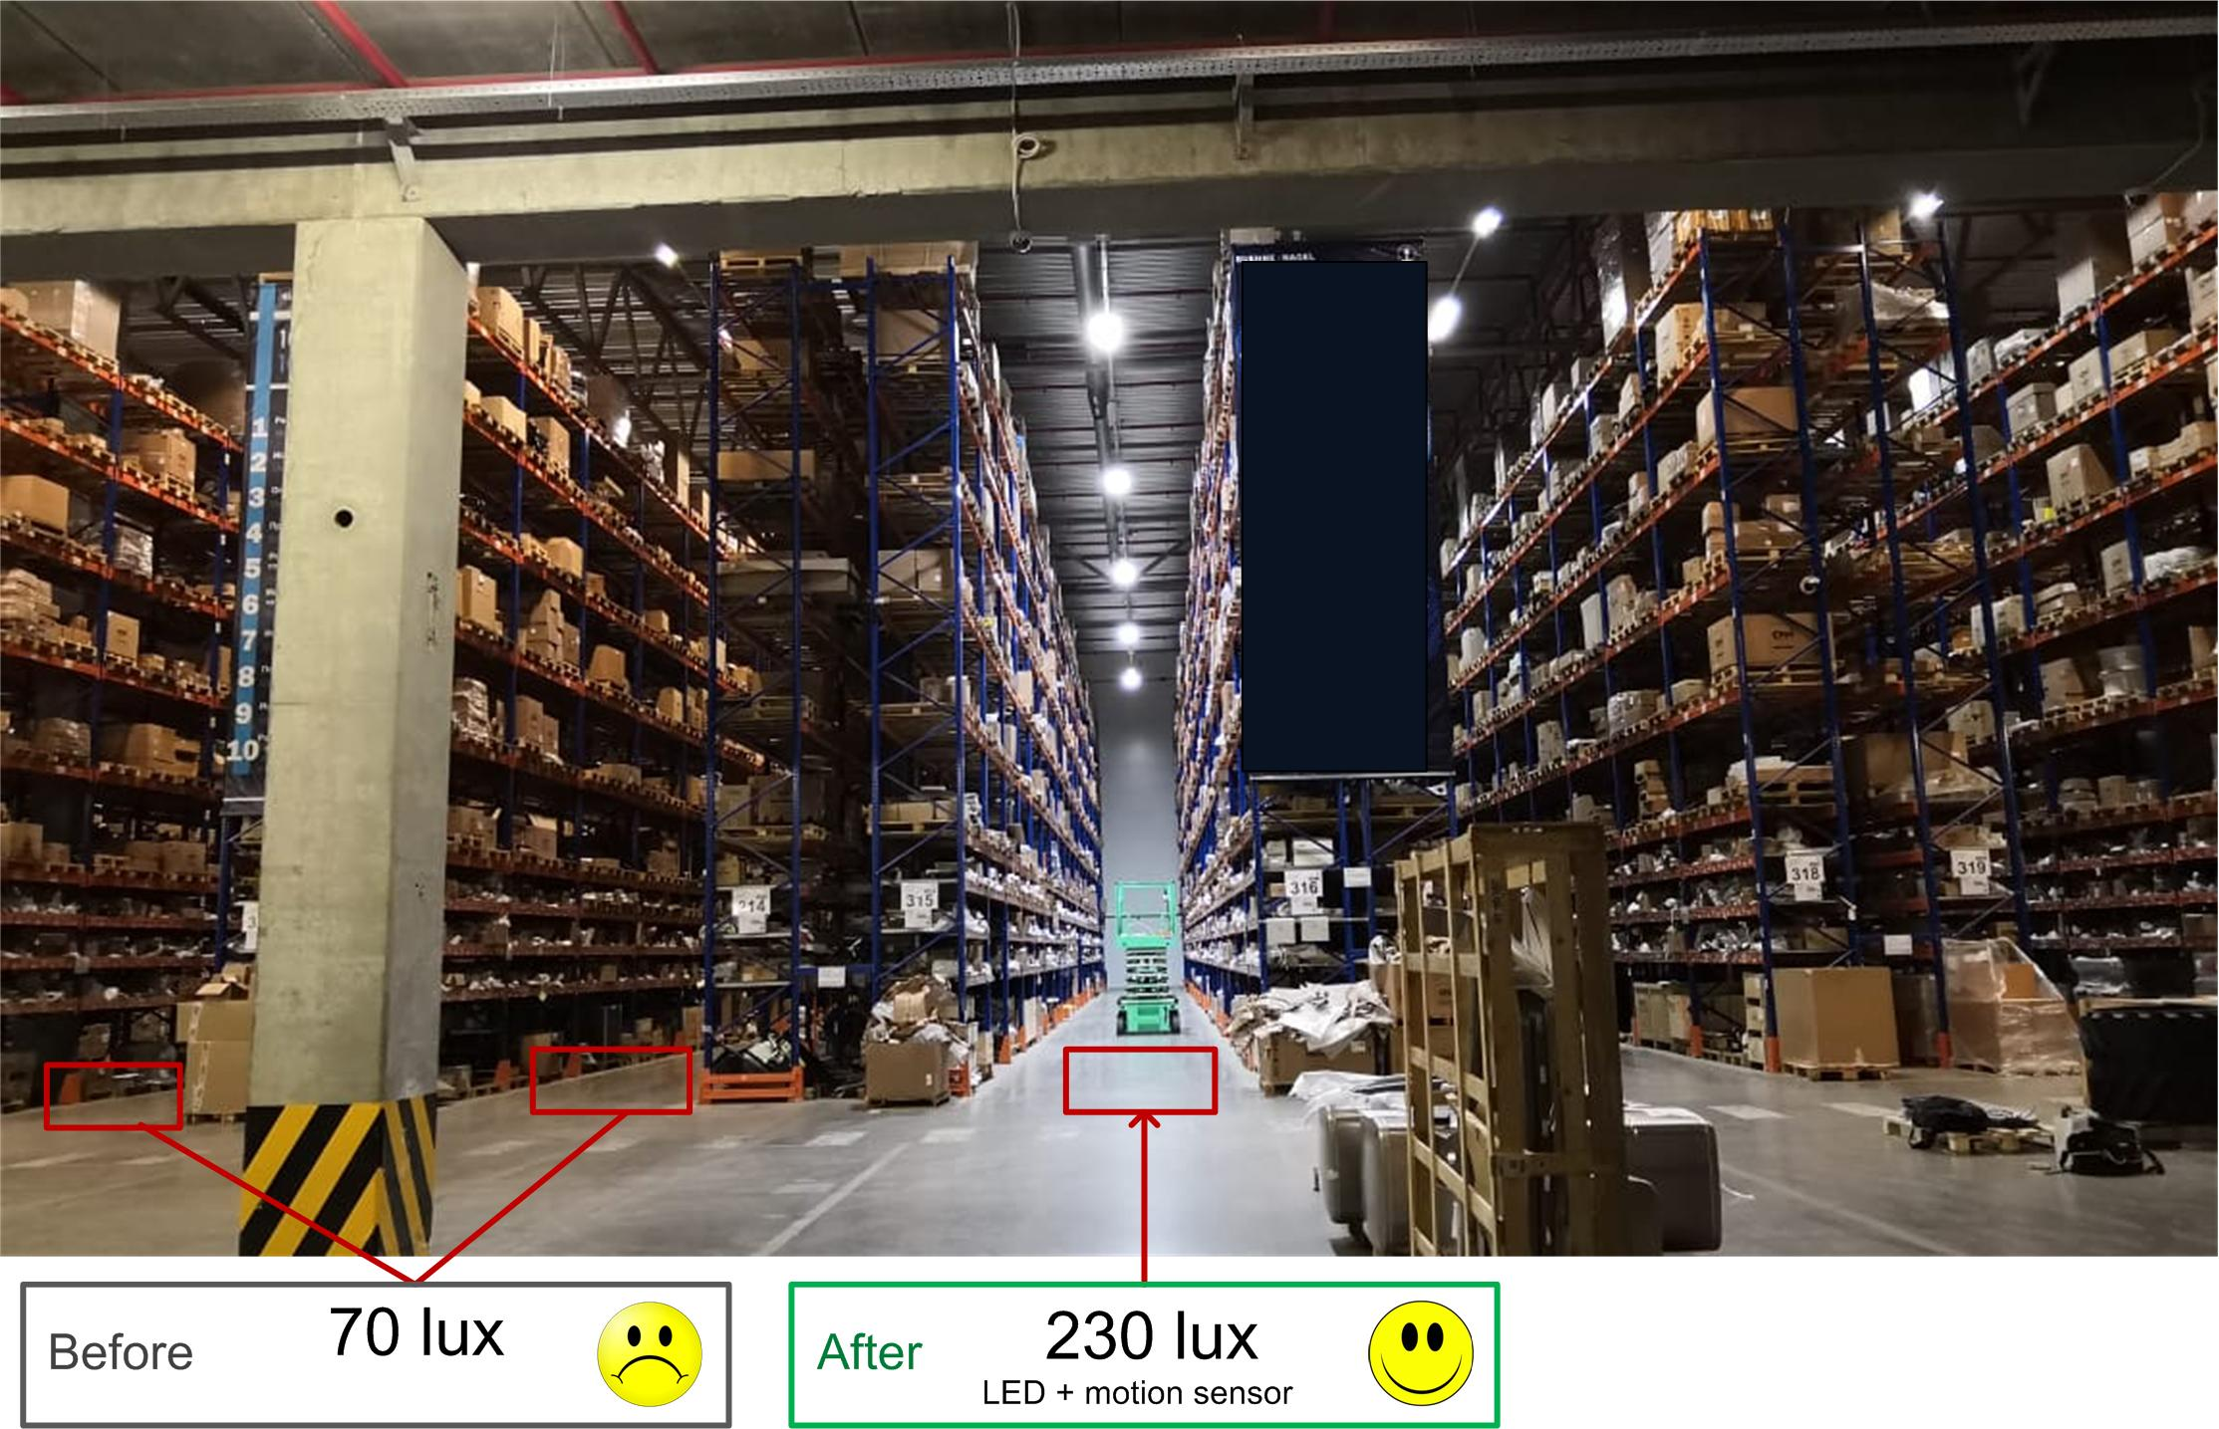
Case Study: Lighting control system for a warehouse
Challenge: How to increase energy efficiency in warehouses with already installed energy efficient lighting fixtures (luminescent with Т5 104 lm/W lamp)?
Warehouse of the Ghelamco company

Slide 10
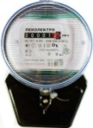
Case Study: Lighting control system for a warehouse
Test at the warehouse
Before:
After:
Type of light fixtures – luminescent T5
Number of light fixtures – 14
Fixture power – 80W
Total power of one alley – 1120W
Type of light fixtures – LED
Number of light fixtures – 6
Fixture power – 121W
Total power of one alley – 726W
Electricity consumption per 6 months with motion sensor (1,5+3,7) - 847 kW*h
Electricity consumption per 6 months - 4420 kW*h
Energy consumption decreased
5.2 times.
The light level increased 3 times!
70 lux
230 lux

Slide 11
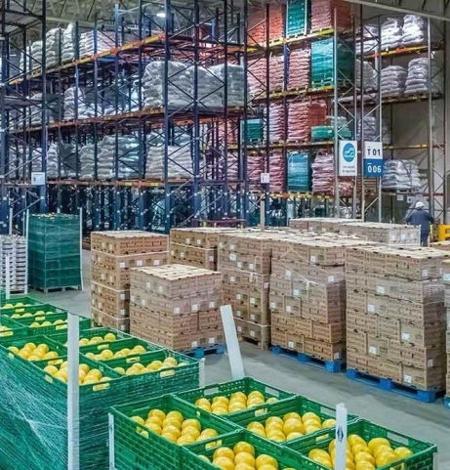
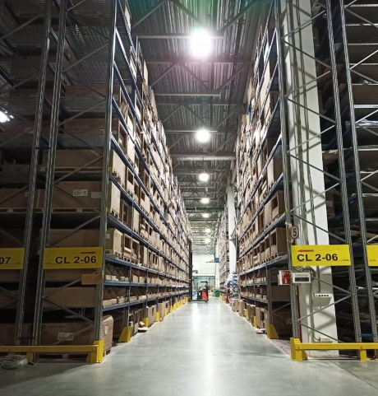
Market
Warehouses are the most profitable and fastest growing segment of the real estate market
719 000 000 m³ refrigerated warehouse capacity in 51 countries!
Storage of vegetables and fruits (high humidity)
Conventional warehouses,
3-30m height
- Our market!
Very-narrow-alleys warehouses (VNA) with a height up to 22m
The sensor complies with the European Safety/Health standards
(EN 62311 2008, EN 62368-1 2014 + AC:2015)

Slide 12
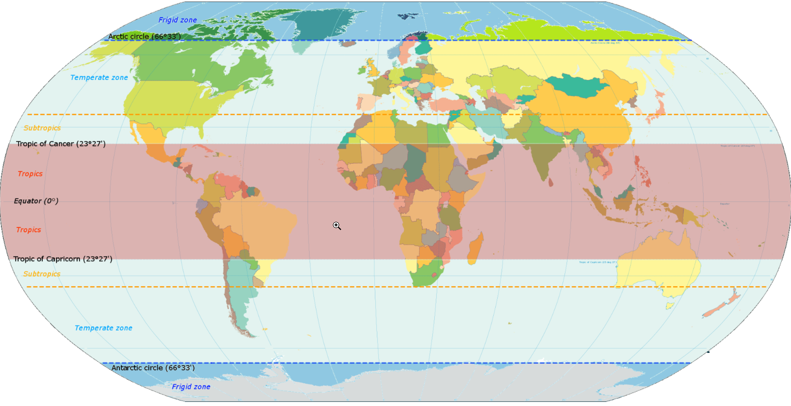
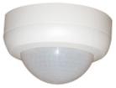
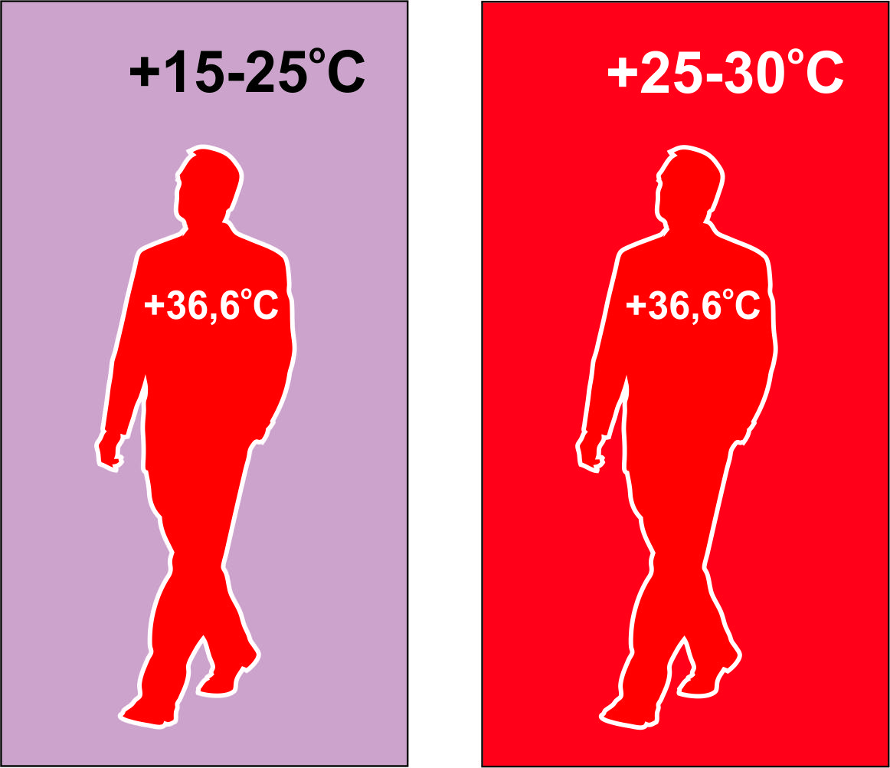
Market
Market with significant advantages for our sensors
Why?
The PIR sensors of our competitors can’t detect a person if the ambient temperature inside the warehouse is about +30ºC
Subtropics
Tropics
Tropics
Subtropics
Our sensor
uses radar motion detection technology, which doesn’t depend on temperature, humidity and drafts

Slide 13
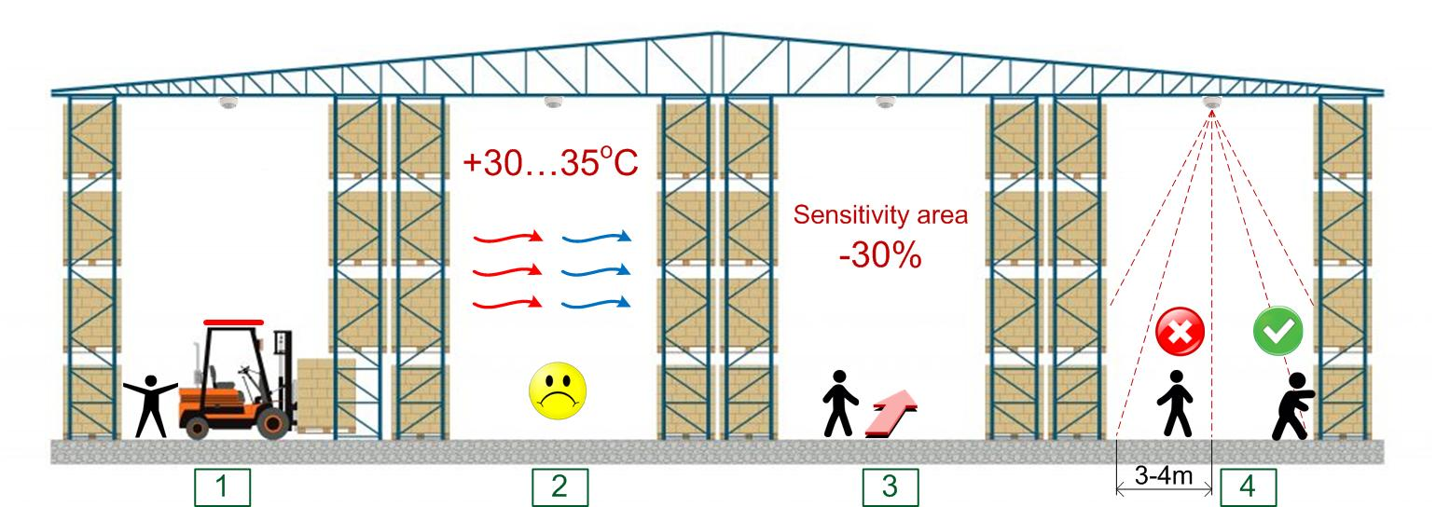
Main disadvantages of infrared motion sensors
React to the difference in the temperature, not to the motion itself
HVAC systems can cause false triggering.
Hot weather might halt infrared motion sensor operation.
Have problems with movement directed to and from the sensor (30% reduction of the coverage area)
Have dead zones of several meters and therefore require a long off-time delay

Slide 14
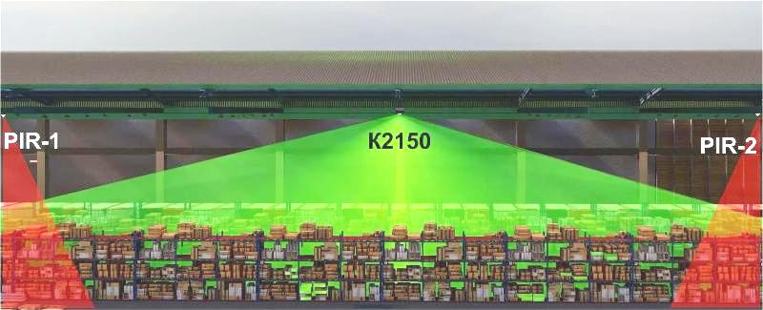
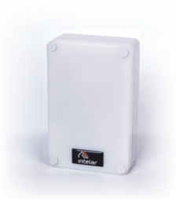
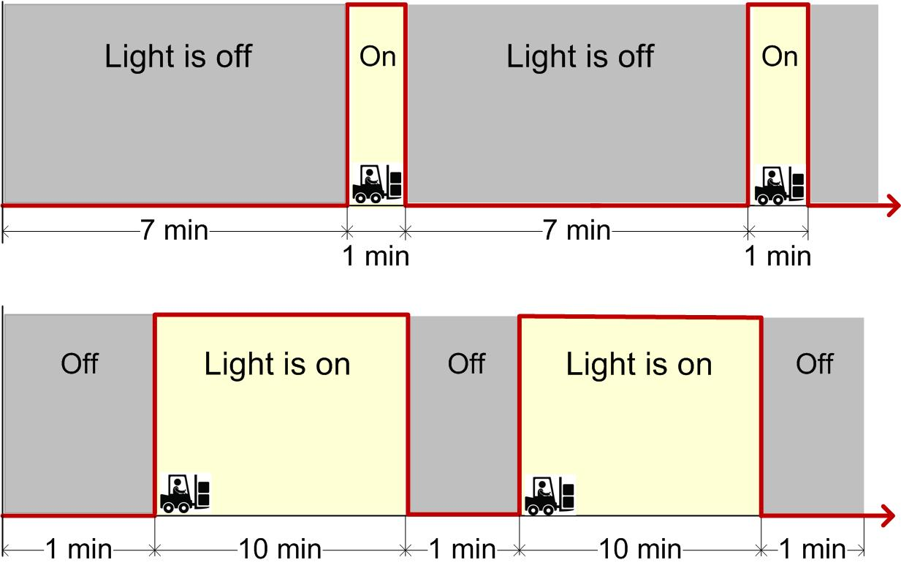
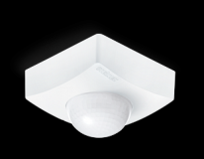
Competitors
How do competitors solve this problem?
If the height of the warehouse does not exceed 14m, they use a scheme with two sensors (PIR) – at the beginning and at the end of the alley + a long time delay (usually 10 minutes)
No solutions, if the warehouse is higher than 14m
And how profitable is such automation for a customer?
Saving 60-80%
Payback period 0.5 -1 year
К2150
К2150
Saving 20-30%
Payback period 2 - 5 year
(the lighting would still working for
10 minutes in an empty alley)
Competitors
Competitors

Slide 15
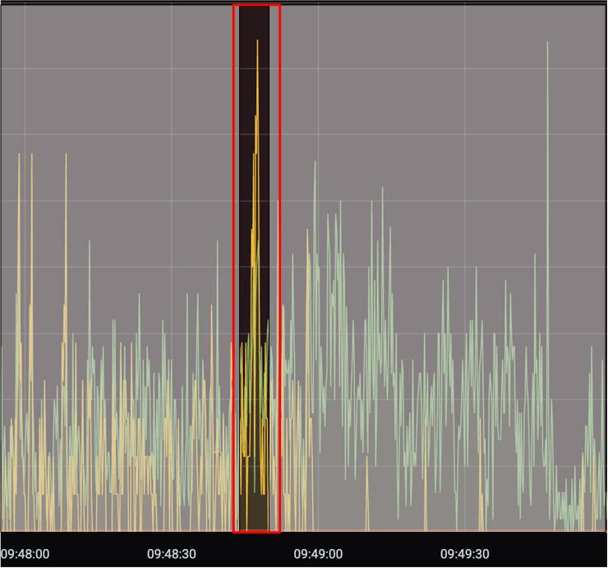
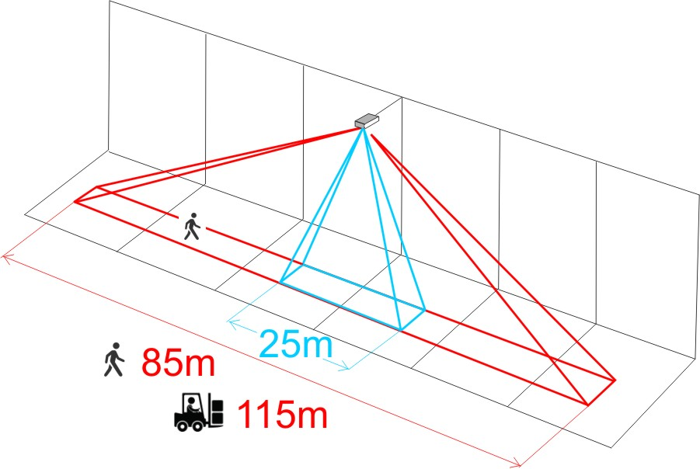
Technology
Технология
Our core advantages
Our know-how is a special mathematical signal processing inside sensor's microprocessor, that increases operation range from 25 meters up to 80 and even more
Comparison K2150 with competitors in warehouses
Progressive microwave-radar technology instead of passive infrared one

Slide 16
How motion sensor К2150 is different from its competitors
Characteristics | Competitors | К2150
Maximum installation height in the warehouses, m | 12 | 30+
The length of the sensitivity zone in the warehouse alley, m | 20 | 85
Sensitivity area, sq. m | 120-400 | 3000
Relay output and smooth light dimming output in one sensor | No | Yes
Can be mounted on the wall and on the ceiling | No, only on the ceiling | Yes
Can be integrated with security alarm systems, IP-cameras, BMS, Automated Process Control Systems | No | Yes
Operating temperature | -10…+65 °C | -30…+65 °C
Can operate in cold storages -30*С | No | Yes
Can run directly from solar cells 12VDC, without converters | No | Yes
Enclosure protection | IP54 | IP65, IP67
The payback period, in years | 2 - 5 | 1

Slide 17
К2150 occupancy detector overview
Main benefits:
Detects a person at a distance of 80m on an area of 3000 sq.m! *
Suitable for warehouses with a height of 3 to 30+ m! *
Can be used in cooling, freezing warehouses *
Can be used in special high humidity warehouses *
Can reliably operates in warehouses located in hot climate * regions
Can be integrated with the security alarm system or IP-cameras
All-weather design, small dimensions 125x80x40 mm
Included in the portfolio of “1000 Solutions to Protect the Environment in a profitable way” of Solarimpulse Foundation, Switzerland.
* - the unique advantages for warehouses

Slide 18
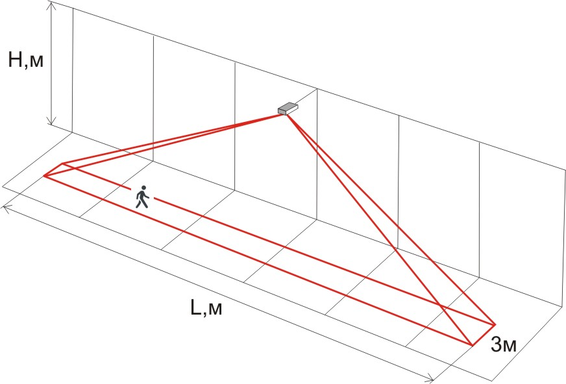
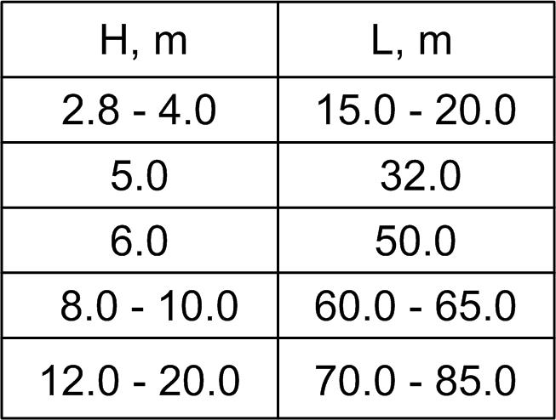
К2150 sensitivity
Sensor’s sensitive area when installed on a ceiling
The length of the К2150 sensor’s sensitive area depends on the installation height H (person’s movement tracing!).
The best detection range results in warehouses:
2018: VNA warehouse with a height of 18m - one sensor in the aisle 84m long (human and loader detection) of the largest local medicines goods distributor
2018: VNA warehouse with a height of 15m - one sensor in the aisle 114m long (loader detection only) of a well-known local logistic operator

Slide 19
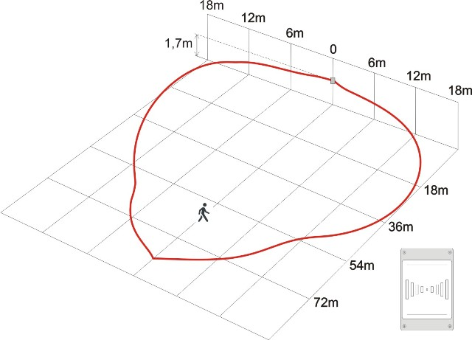
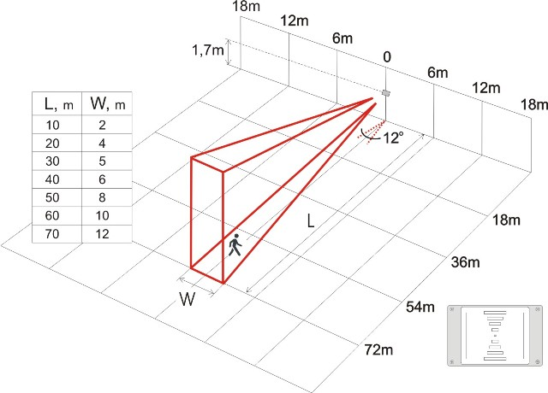
К2150 sensitivity
Sensor’s sensitive area when installed on a wall
The К2150 sensor’s sensitive area when vertically installed on a wall
The К2150 sensor’s sensitive area when horizontally installed on a wall.

Slide 20
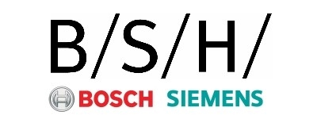
Results and achievements
More than 40 successful projects
High reliability. Not a single return for repairing for 3 years of selling!
Repeated sales ~ 100%
Our customers have saved 20 million kWh of electricity
Reduced CO2 emissions by 8000 tons (400 g of CO2/kWh)
Munich, 2021
Lausanne, 2018
Since July 2018 the K2150 sensor has been labeled as World efficient solution from Solarimpulse Foundation, Switzerland

Slide 21
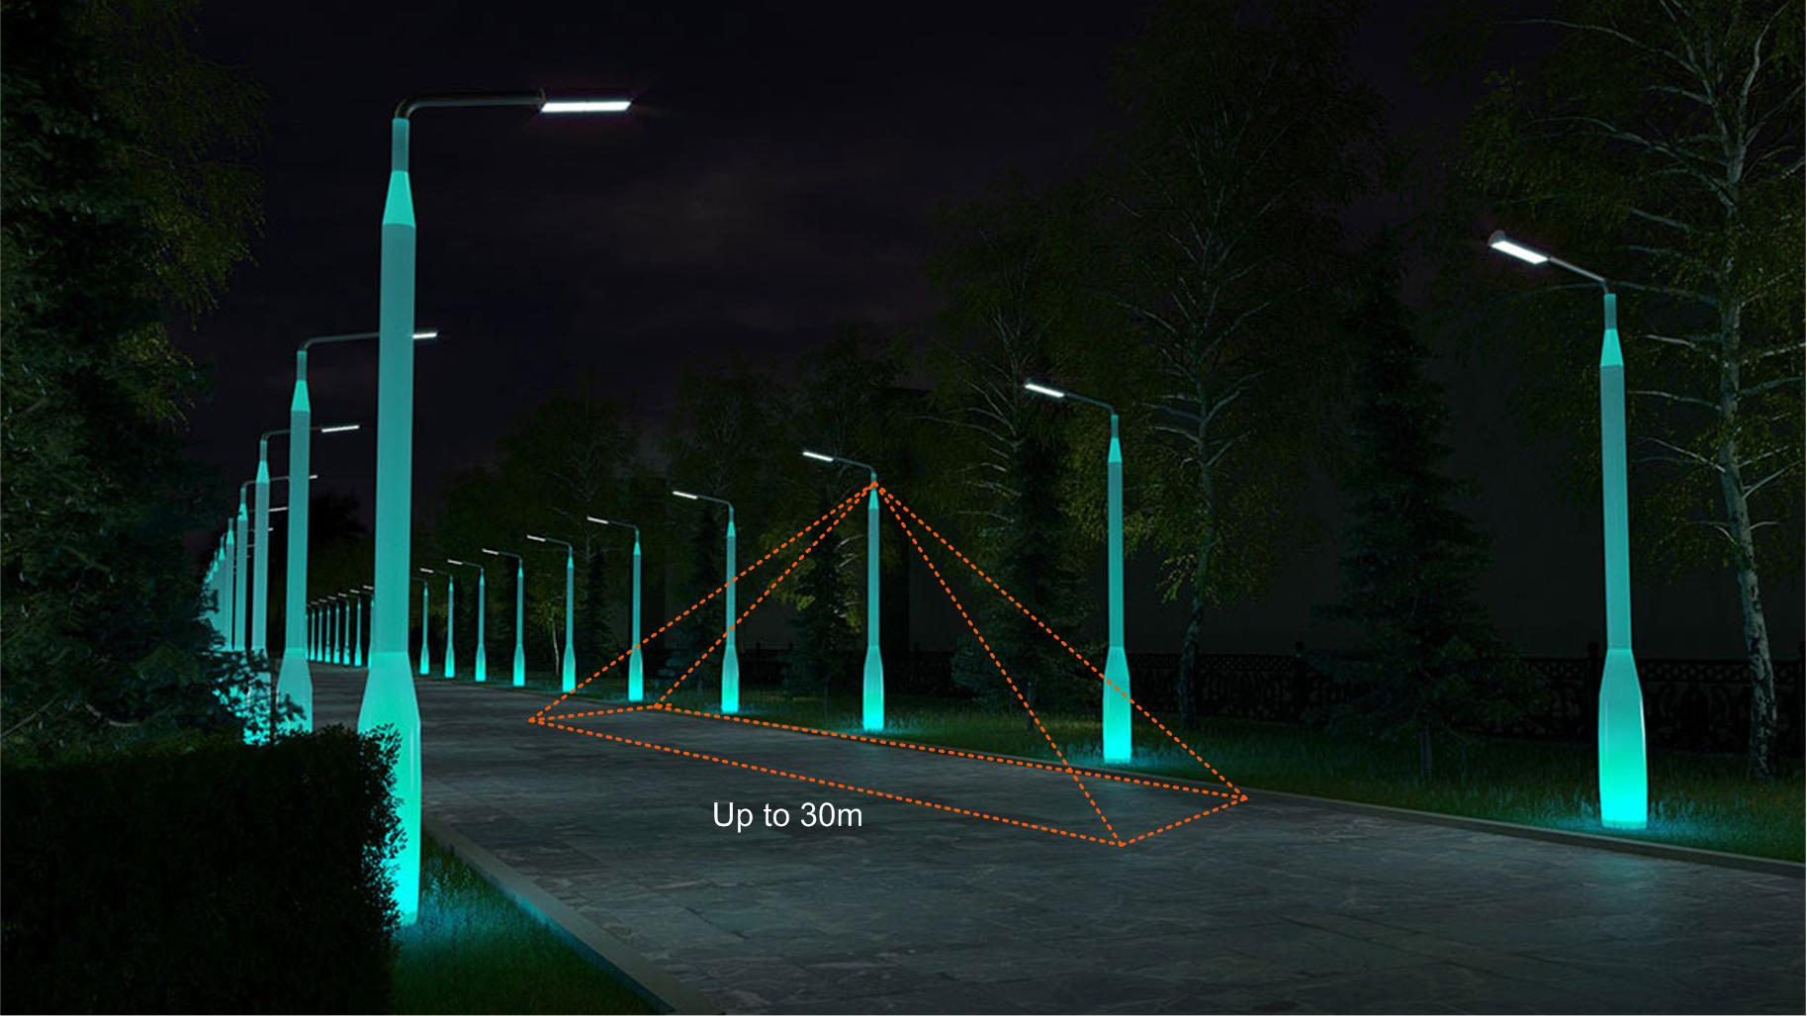
Autonomous solar lighting systems
Autonomous solar lighting systems –
light by motion.
Reducing the battery capacity by several times!

Slide 22
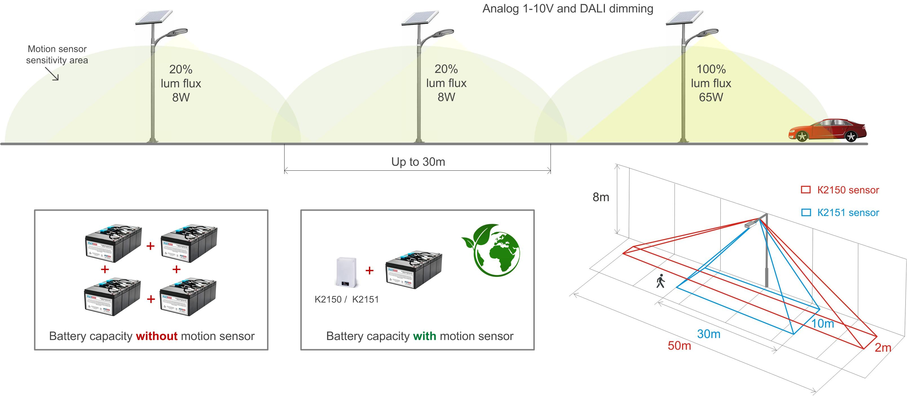
Autonomous solar lighting systems
Reducing the battery capacity by several times!

Slide 23
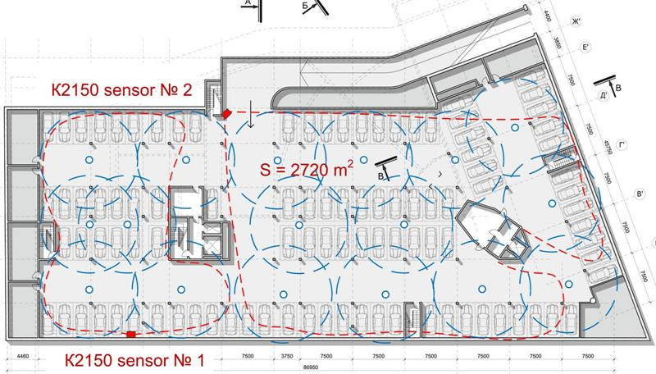
Other sensor’s K2150 applications
Two K2150 sensors instead of 17 ceiling PIR sensors in underground car parking lot.

Slide 24
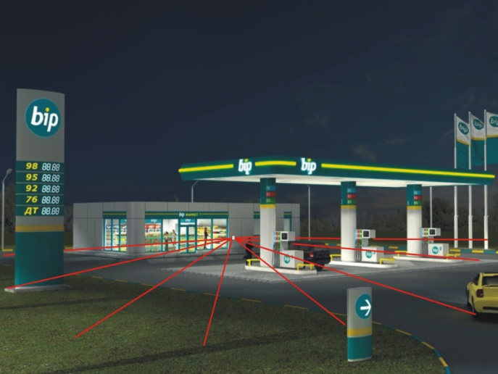
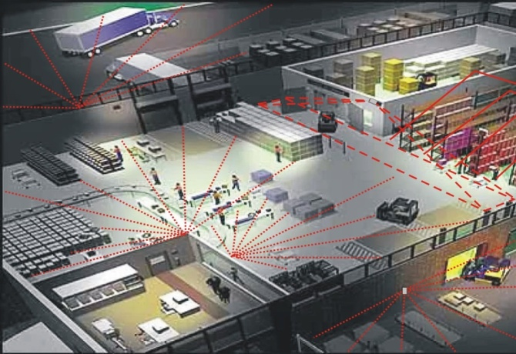
Other sensor’s K2150 applications
Gas stations: ordinary and the ones without operators
Automatic lighting control
IP cameras control
Smart factories: buildings and territories automation
Presence of a person or any moving object in an area of 10 to 3000 square meters
Any output interface on request

Slide 25
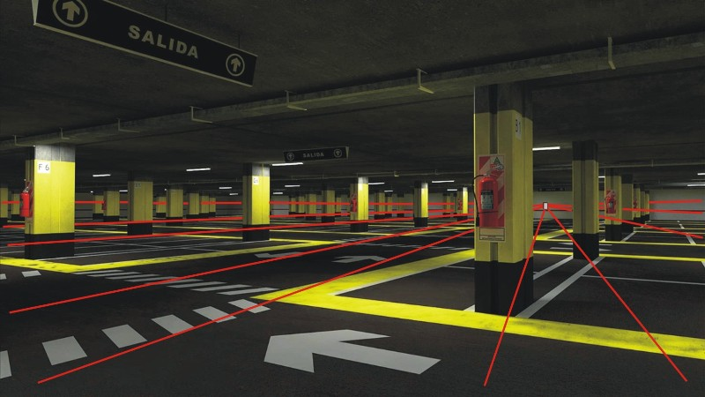
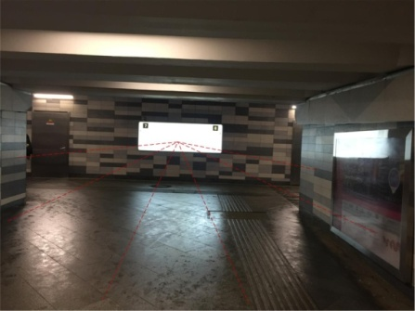
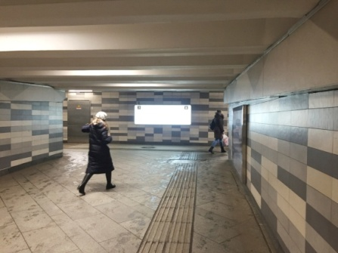
Other sensor’s K2150 applications
Pedestrian undercrossing
When the undercrossing is empty, К2150 sensor smoothly reduces the lighting
The sensor can be hidden behind any radiotransparent surface. For example, mounted into the light box.
Car parking lots
Presence sensor K2150 has a big range – about 3000 sq.m
One sensor replaces 6-8 PIR sensors
The length of cable lines and the cost of installation reduces significantly

Slide 26
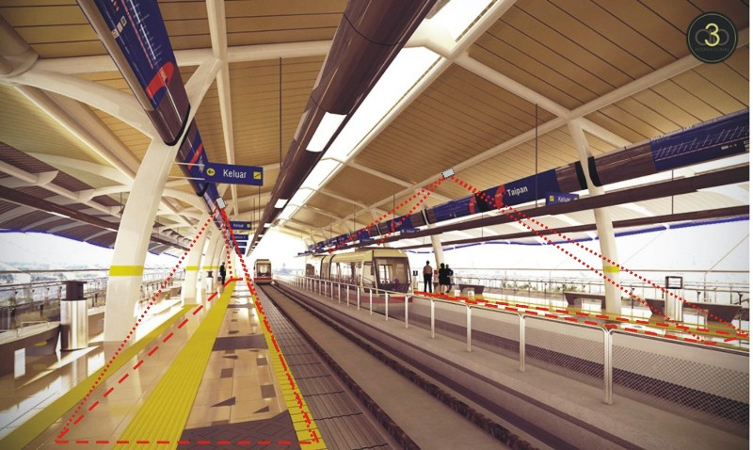
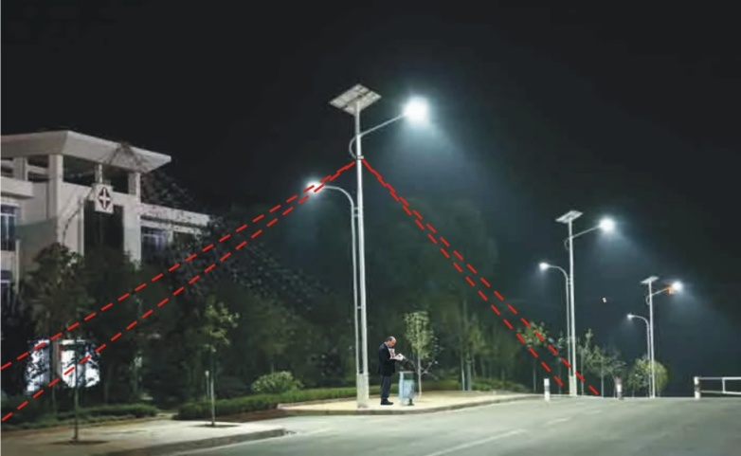
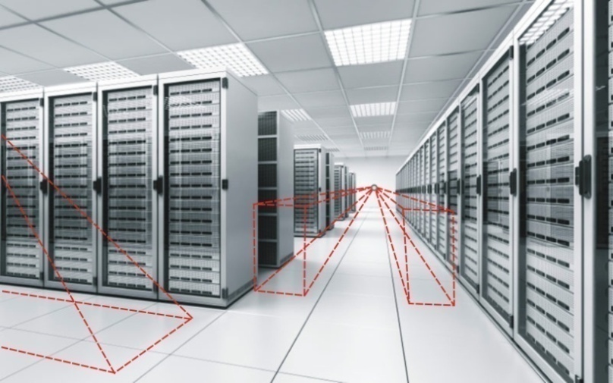
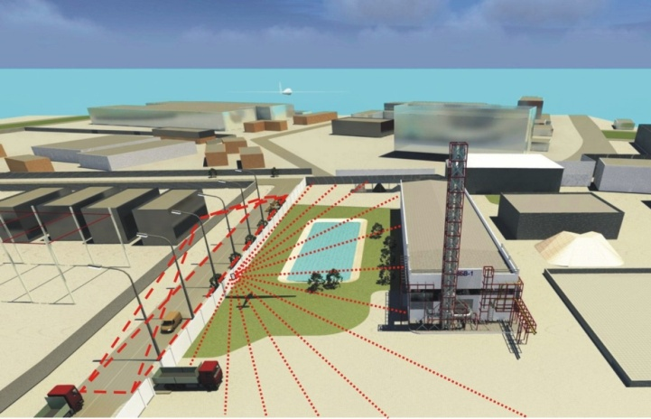
Other sensor’s K2150 applications

Slide 27
Viktor Verbovskii
CEO of Intelar
Topliski put, BB, Budva 85310, Montenegro
+382 68366543
va@lightbymotion.com
Representative office in Netherlands:
Minister Lelylaan 70
2285HK Rijswijk ZH
+316 24329212
Cost-effective technology with a short payback period

